Slide 1

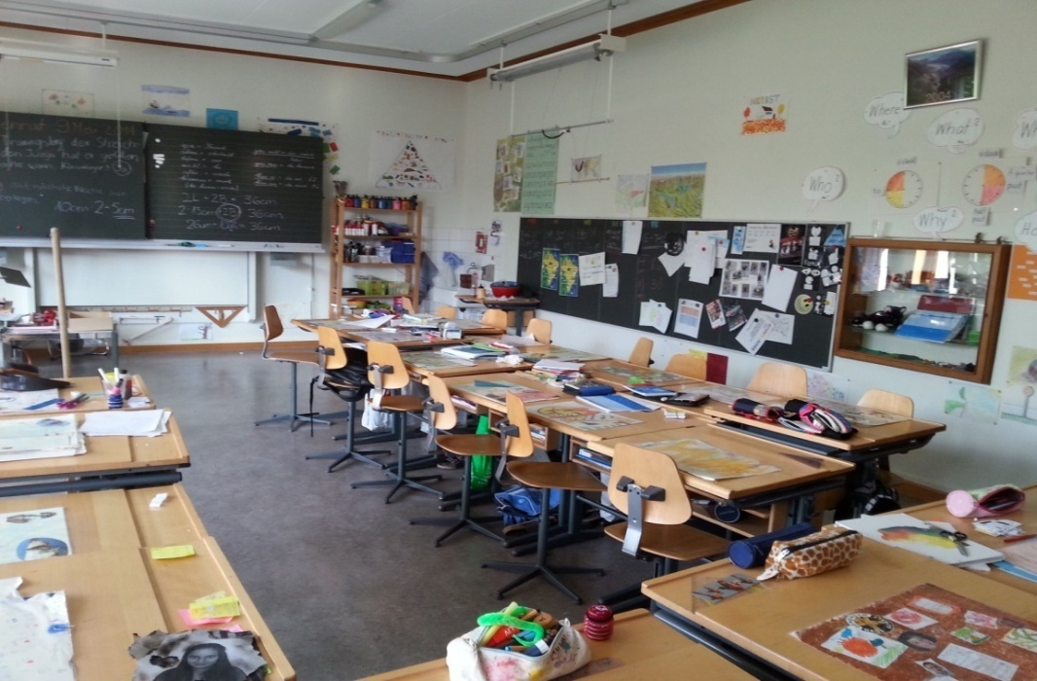
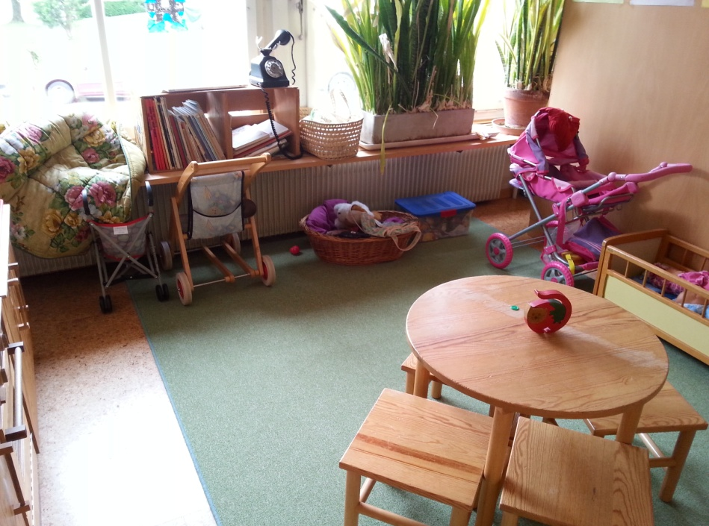
EDUCATION IN SERBIA AND VOJVODINA
Svetlana Lazić, professor of Pedagogy
Preschool Teacher Training College in Novi Sad
Novi Sad, September, 1st 2015.

Slide 2
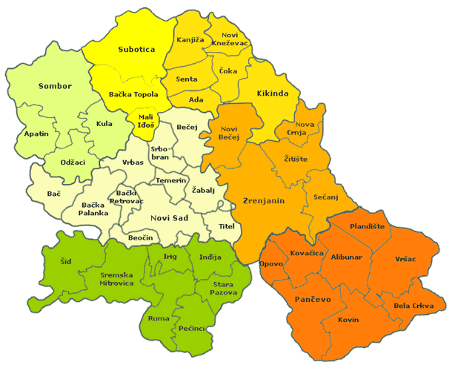
AUTONOMOUS PROVINCE OF VOJVODINA
39 municipalities 6 cities 45 local communities
Vojvodina is in the northern part of Serbia

Slide 3
THE SYSTEM OF EDUCATION
Education
1.
Kindergarten (PE)
2.
Primary school (EE/PE)
3.
Secondary II school (SE)
4.
University
(AS, VS)

Slide 4
N
N
PE
PE
PE
PP
Preschool Education (Kindergarten)
1
2
3
4
5
6
7
8
Primary /Elementary school
1
2
3
4
For work
Secondary II school
For work and study
Gymnasium
AE
AE
AE
MA
MA
University Education 3+2
AE
AE
AE
AE
MA
University Education 4+1
Vocational Education 3+1
Preschool Teacher Training College
VE
VE
VE
SVE

Slide 5
The system of Preschool / Pre-primary Education
Nursery and care from 6 months or 1 year to 3 years. Children are in the system of preschool education.
IT IS NO COMPULSORY
Preschool educational programme for children from 3 to 6 (2,6 to 5,6). Children are in the system of preschool education.
IT IS NO COMPULSORY
Pre-primary programme for children from 6 to 7 (5,6 to 6,6) as a preparation for school .
IT IS COMPULSORY BY LAW.

Slide 6
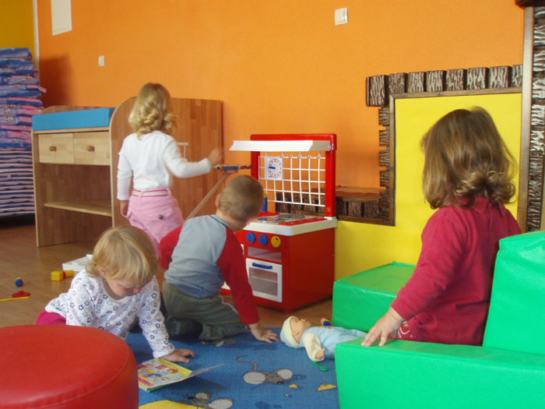
PRESCHOOL EDUCATION IN SERBIA

Slide 7
PRESCHOOL EDUCATION
IN SERBIA
Budgete extract for
Preschool Education
Coverage of children in Preschool Education
Serbia 0,43%
Countries from OECD 0.5%
Distinction from 0,07% is enough to cover all children (100%) by short or specialised programmes of Preschool Education.
2002 = 32% children from 3 to 6 (2,6 to 5,6)
2012/2013 = 47% children from 3 to 6 (2,6 to 5,6)
= 97% children in PPE

Slide 8
PRESCHOOL EDUCATION
IN VOJVODINA 45 local communities (39 municipalities + 6 cities)
44 local communities has Preschool institution established by local community (municipality or city)
All of them organise institutional education for preschool children ages 3 - 6
1 local community (Nova Crnja) implement institutional preschool education by local schools. This is referred on children included in pre-primary programme.
All 45 local communities organise one year pre-primary preparation programme for school in kindergartens.
Languages: Serbian, Hungarian, Slovakian, Rumanian, Ruthenian and Croatian.

Slide 9
PRESCHOOL EDUCATION
Decreasing number of children
In school 2014/2015 scholl year 17.505 children enrolled in one year pre-primary programme in Vojvodina
In 2014/2015 = 17.505 children (705 less than in 2013/2014 = 18.210)
In 2013/2014 = 18.210 children (600 less than in 2012/2013 = 18.810)
In 2012/2013 = 18.810 children (600 less than in 2011/2012 = 19.188)
In 2011/2012 = 19.188 children (378 less than in 2010/2011 = 19.566)
TOTAL = 2.061 CHILDREN LESS
The main problems in 2015 regarding petitions submitted to Ombudsman’s Office:
  Disciplinary procedure againts preschool teacher. Preschool teacher was sent down (removed) from her working place for suspicion of child corporal abuse. Parents wanted her back.
  Photography of children in newspapers without parent’s agreement. The best interest of the child?
  Lack of public procurement. Municipality wasn’t informed about withdraw of Preschool Institution from the public procurement and parents should have to pay for better quality of children’s education. Municipality should control all public procurement in institutions which are in their juristiction.

Slide 10
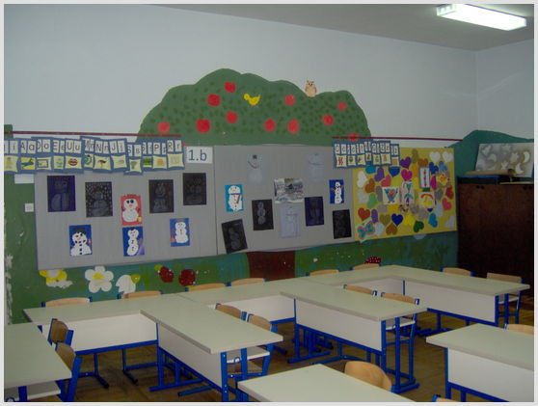
PRIMARY EDUCATION IN SERBIA

Slide 11
PRIMARY EDUCATION
Decreasing number of children in Vojvodina
In school 2014/2015 year 17.848 children were enrolled in the first grade of primary school in Vojvodina. They are divided in 888 non combined classes and 132 combined classes.
In 2014/2015 = 17.848 chilren (803 less than in 2013/2014 = 18.651)
In 2013/2014 = 18.651 children (442 less than in 2012/2013 = 19.093)
In 2012/2013 = 19.093 children (527 less than in 2011/2012 = 19.620)
In 2011/2012 = 19.620 children (912 less than in 2010/2011 = 20.532)
TOTAL 2.684 CHILDREN LESS.
Incrising number of children with dissabilities (105) enrolled in 1st grade of Primary school compared to last school year.

Slide 12
PRIMARY EDUCATION
346 elementary schools are spread over the Autonomous Province of Vojvodina.
344 are state primary schools
2 are private primary schools (both of them are in Novi Sad)
Languages: Serbian, Hungarian, Slovakian, Rumanian, Ruthenian and Croatian.
Variaties: monolingual, bilingual, trilingual (Serbian, Slovakian, Hungarian)
4 schools in NS are bilingual (Serbian-Hungarian – Petefi Šandor, Sonja Marinković, Nikola Tesla, Jožef Atila)
3 schools covered by authority of city of Novi Sad are bilingual too (1 Slovakian-Serbian in Kisač, 2 Serbian-Hungarian in Rumenka and in Budisava)
Problems: some schools do not have pupils to enroll and some of them should be closed because of school rationalization; problems regarding inclusion; religius education...

Slide 13
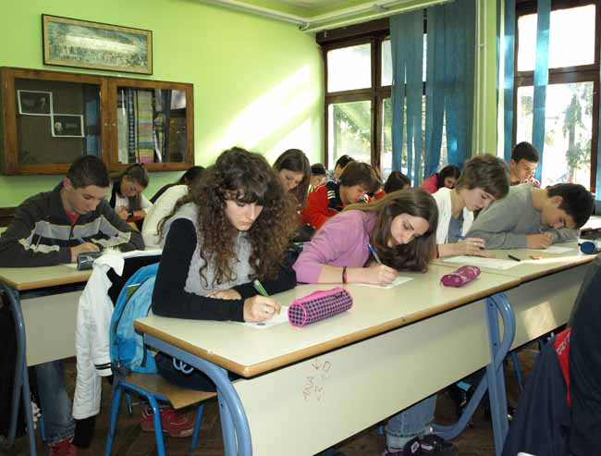
SECONDARY EDUCATION IN VOJVODINA (Secondary II school)

Slide 14
SECONDARY EDUCATION
Is organised in 40 municipalities in AP of Vojvodina (5 municipalities do not have secondary schools)
131 secondary schools;
121 are state secondary schools
  26 grammar schools (gymnasiums)
  74 skilled schools (10 of them are mixed for 3 and 4 years of schooling)
  10 art schools
  10 secondary schools for pupils with some difficulties (with professional skills for 1, 2 and 3 years)
  21 private schools are registered, but only in 10 of them pupils are enrolled
Languages: Serbian, Hungarian, Slovakian, Romanian, Rutherian, Croatian.

Slide 15
SECONDARY EDUCATION
Decreasing number of pupils in Vojvodina
In 2014/2015 16.733 pupils were enrolled in secondary schools.
In 2013/2014 17.605 pupils were enrolled in secondary schools
In 2012/2013 19.961 pupils were enrolled in secondary schools.
__________________________
Distinction is 3.228
Languages: Serbian, Hungarian, Slovakian, Romanian, Rutherian, Croatian.
Problems: peer violation, sexual harassment of girl, cyber criminal, alcohol, drugs, unprotected sexual activities, juvenile pregnancy...

Slide 16

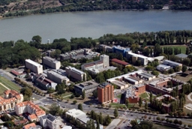
UNIVERSITY EDUCATION IN SERBIA

Slide 17
UNIVERSITY EDUCATION IN SERBIA
State Universities
  6 cities (BG, NS, NI, KG, PR, NP)
  8 universities (3 in Belgrade » Belgrade University; University of Art; University for Military and Police Education)
Private Universities
  2 cities
  10 universities (2 in Novi Sad, the rest in Belgrade)

Slide 18
UNIVERSITY EDUCATION
University of Novi Sad
Provincial Secretariat for Education, Administration and National Communities
14 faculties
  9 has administration centre in Novi Sad
  3 has centre in Subotica
  1 has centre in Sombor
  1 has centre in Zrenjanin
  Other institutions/centres
Provincial Secretariat established 9 training colleges in Vojvodina
  3 are techican training colleges
  1 is business training college
  5 are preschool teacher training colleges
Languages: mostly Serbian. In some faculties some subjects allows use of national community language, mostly Hungarian and Romanian.

Slide 19
EDUCATION FOR DEMOCRATIC CITIZENSHIP AND HUMAN RIGHTS EDUCATION (EDC/HRE)
From 4th to 7th March 2015. approximately 70 participants from
  11 pedagogy units from Preschool institution in Novi Sad,
  5 primary schools,
  4 secondary II schools
participated in the piloting process for preparing EDC/HRE manuals for implementing in educational practice.

Slide 20
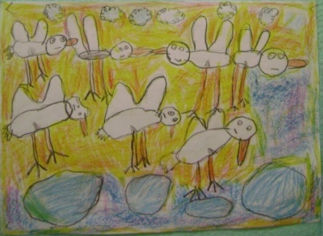
Child’s Rights Implementation in Kindergarten
Child’s Rights Implementation cover 3 dimensions of child’s life:
Cognitive dimension – learning and spreading knowledge of own rights.
Cultural dimension – democracy and child’s rights are pedagogical guidelines in Preschool, Primary and Secondary II teacher’s work and conducting.
Participative dimension – children actively participate in the life of kindergarten and school.
ABOUT child’s rights.
TROUGH child’s rights.
FOR child’s rights.

Slide 21
9 key concepts of EDC/HRE

Slide 22
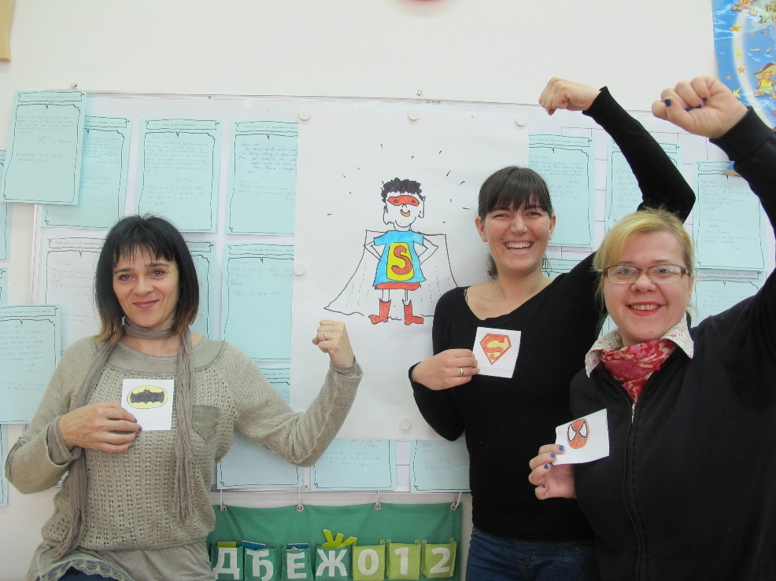
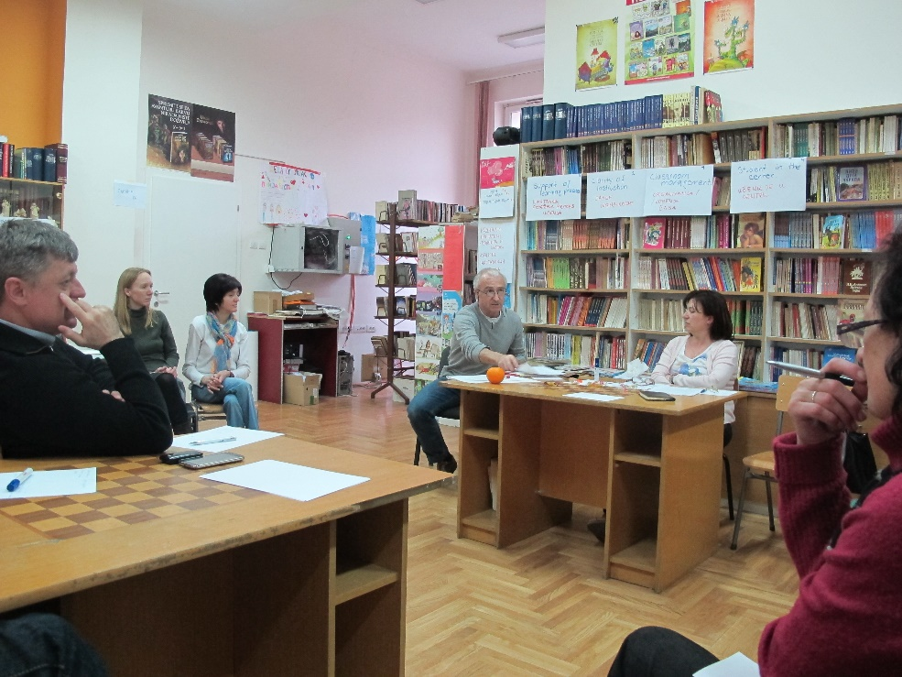
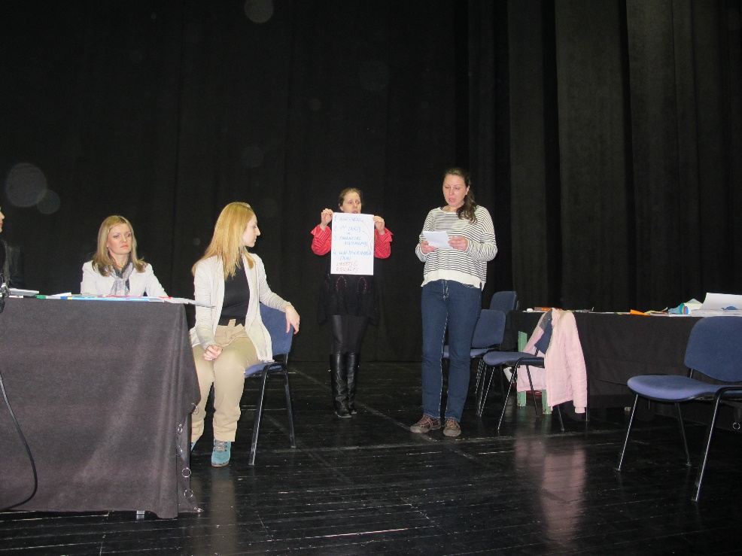
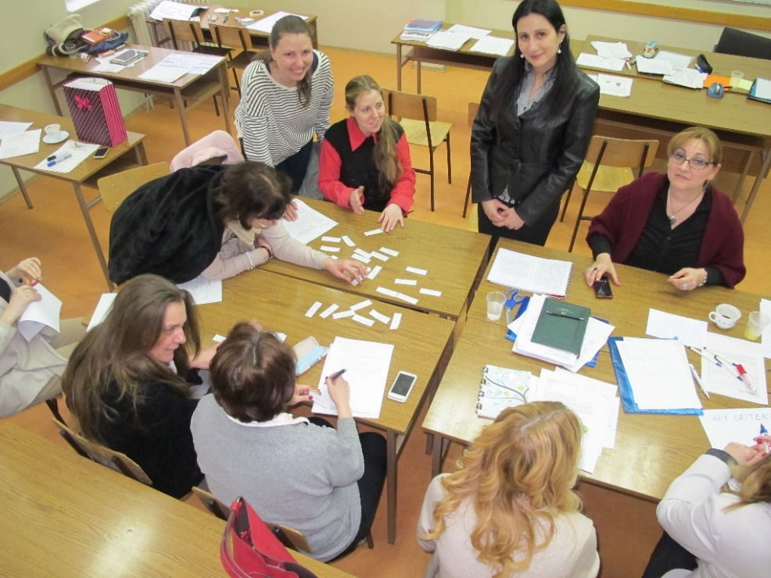
Is child who presents the class superhero or just regular child?
Milan’s choice – education or work?
What is mediation? How it works? Could it be implemented in Secondary II school?

Slide 23
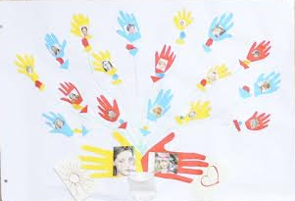
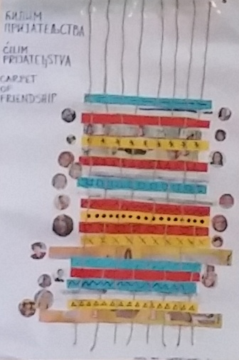
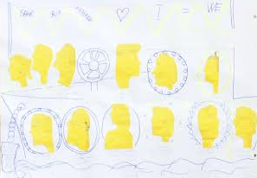
Bouquet
Carpet
Ship

Slide 24
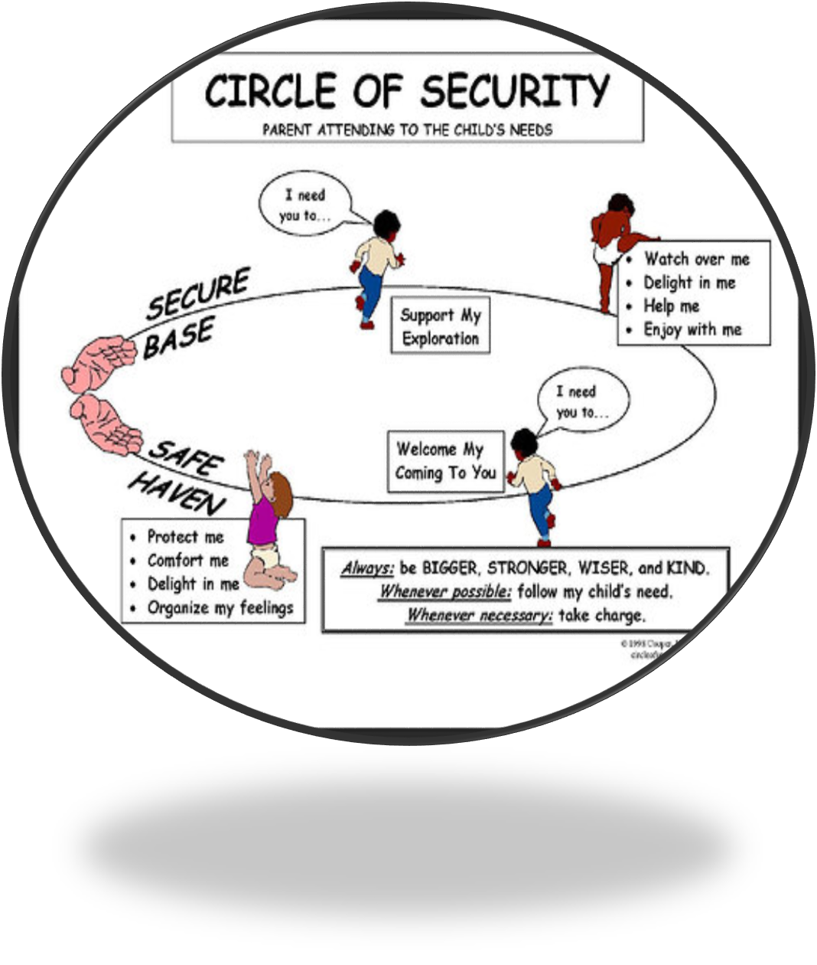
The upper palm: support, enjoy, help, delight, let me...
Child’s competences for care.
The bottom palm: comfort, cherish, cuddle, hug, paddle…
Trough this circle I will become stronger!

Slide 25
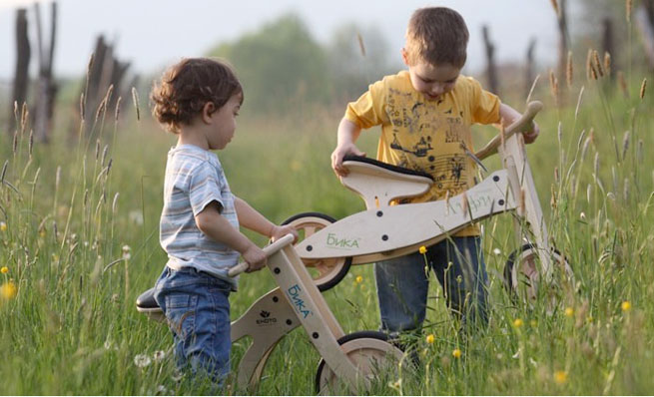
Thank you

